Slide 1
Social Choice and Group Decisions (Voting)
Edited by: Fuad Noman
Prepared by: Julian Gutierrez
School of Information Technology, Monash University Malaysia
FIT5226: Multi-Agent Systems and Collective Behaviour
Notes:
Social choice and group decision-making refer to the process of making collective decisions, typically involving a group of individuals with varying preferences or opinions. It is a field of study that examines the methods, rules, and procedures used to reach decisions that reflect the collective will or choice of the group. Social choice and group decision-making have applications in various fields, including politics, economics, ethics, and public policy. Researchers and policymakers continuously explore these topics to improve the quality of collective decisions and ensure they align with societal values and objectives.
In the context of game theory, social choice and group decisions refer to the mechanisms and strategies employed by a group of rational individuals to collectively make decisions, often in situations involving conflicts of interest, strategic interactions, and varying preferences. Social choice and group decisions in game theory are essential for understanding how rational actors make choices in collective decision-making settings. These concepts help analyze elections, negotiations, and other scenarios where individuals must reconcile their preferences with those of the group while accounting for strategic behavior and incentives.

Slide 2
Motivation and acknowledgement¹
Let’s play!
A: Australian (Men at Work - Down under)
B: British (The Beatles - Real love)
C: Canadian (Alannah Myles - Black velvet)
¹Slides based on Michael Wooldridge’s teaching materials.
10/9/2024
FIT5226-S2-2024
2/33
Notes:
How voting works.

Slide 3
Social choice theory
Social choice theory is about aggregating preferences
Classic example: Voting systems
Problem: Combining preferences to derive a social outcome
10/9/2024
FIT5226-S2-2024
3/33
Notes:
Social choice theory is a branch of social science and economics that deals with the aggregation of individual preferences to arrive at a collective or social choice. It focuses on understanding how to make decisions on behalf of a group when individual members have varying preferences. This theory plays a crucial role in various fields, including economics, political science, ethics, and philosophy. Here are some key points related to social choice theory:
Individual Preferences: Social choice theory begins with the assumption that there are multiple individuals, each with their own preferences over a set of alternatives. These alternatives could be policy choices, candidates in an election, or any decision that affects the group.
Social Welfare Function: The central concept in social choice theory is the social welfare function. This function takes individual preferences as input and produces a social preference ordering or outcome. The goal is to design a social welfare function that fairly represents the collective preferences of the group.
Voting Systems: A classic example of social choice theory is the study of voting systems. Voting mechanisms, such as majority rule, plurality voting, and ranked-choice voting, are used to aggregate individual votes into a collective decision. Different voting systems can yield different outcomes, and social choice theory helps evaluate their properties.
Arrow's Impossibility Theorem: A fundamental result in social choice theory is Arrow's Impossibility Theorem, developed by economist Kenneth Arrow. This theorem states that there is no perfect voting system that can consistently satisfy a set of desirable criteria, such as Pareto efficiency, non-dictatorship, and independence of irrelevant alternatives.
Voting Paradoxes: Social choice theory highlights various paradoxes and challenges in aggregating individual preferences. The Condorcet paradox, for example, occurs when a majority prefers alternative A to B, B to C, and C to A. Resolving such paradoxes is a key concern.
Fairness and Equity: Social choice theory also delves into questions of fairness and equity in collective decision-making. It explores how to design mechanisms that consider the interests and welfare of all members of the group.
Public Choice: In political science, social choice theory is applied to analyze the functioning of democratic systems, public policies, and the decision-making processes of governments and legislative bodies. It helps evaluate the implications of different voting rules and electoral systems.
Mechanism Design: Beyond voting, social choice theory is used in mechanism design, where designers create rules or mechanisms that elicit truthful preferences from participants. This is especially relevant in auctions and public goods provision.
Borda Count: The Borda Count is a well-known voting method in social choice theory. It assigns points to each alternative based on the ranking provided by voters. The alternative with the highest total score is considered the winner.
Social choice theory is essential for understanding and improving decision-making processes in various contexts, from elections and public policy to market design and resource allocation. It offers a framework for exploring the trade-offs and challenges involved in aggregating individual preferences to reach a collective choice that respects fairness and equity.

Slide 4
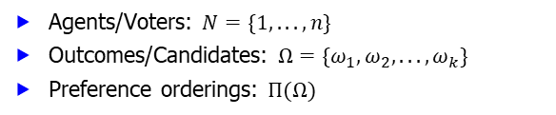
Social choice theory: A formal model
Agents/Voters: $N=\{1, . . . , n\}$
Outcomes/Candidates: $Ω=\{ω_{1}, ω_{2}, . . . , ω_{k}\}$
Preference orderings: $Π(Ω)$
10/9/2024
FIT5226-S2-2024
4/33
Notes:
In social choice theory, a formal model is used to describe the components involved in collective decision-making. Here are the key elements of this formal model:
Agents/Voters (𝑁): These are the individuals participating in the decision-making process. The set 𝑁 represents the voters, and it typically consists of 𝑛 individuals, where 𝑛 is the total number of agents.
Outcomes/Candidates (Ω): These are the available alternatives, choices, or candidates that the agents are selecting from. The set Ω encompasses all the possible outcomes under consideration, denoted as $ω_{1}$, $ω_{2}$, and so on, up to $ω_{k}.$
Preference Orderings (Π(Ω)): Each agent in the set 𝑁 has their own preference ordering over the outcomes in Ω. Π(Ω) represents the space of all possible preference orderings. A preference ordering is a ranking of the outcomes, indicating the agent's order of preference from most preferred to least preferred.
These three components form the foundation of the formal model in social choice theory. The goal is to aggregate the individual preference orderings of the agents to determine a collective choice or outcome that represents the group's preferences. Various voting rules and mechanisms are designed and analyzed to achieve this aggregation, taking into account criteria such as fairness, consistency, and efficiency.
Social choice theory explores the complexities and challenges of finding a suitable method to arrive at a collective decision that respects the preferences and values of all agents, despite potentially conflicting individual rankings of the outcomes. This theory plays a crucial role in understanding democratic processes, voting systems, and collective decision-making in various fields, including economics, political science, ethics, and philosophy.

Slide 5
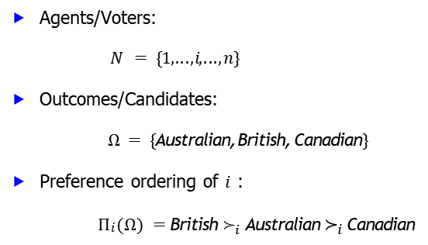
Example: A preference ordering
Agents/Voters:
$$N = \{1, . . . , i , . . . , n\}$$
Outcomes/Candidates:
$Ω = \{$Australian, British, Canadian$\}$
Preference ordering of $i$ :
$Πi (Ω) =$British $≻_{i}$ Australian $≻_{i}$Canadian
10/9/2024
FIT5226-S2-2024
5/33
Notes:
In this example, we have an agent or voter, denoted as “i," with a preference ordering over a set of outcomes or candidates. The agent's preferences over the outcomes in the set Ω = {Australian, British, Canadian} are represented as follows:
$Π_{i}(Ω) =$British $≻_{i}$Australian $≻_{i}$ Canadian
In this preference ordering:
The symbol "$≻_{i}$" represents "preferred to" or "greater preference" for agent $i$.
The agent $i$'s most preferred outcome is "British."
The agent $i$'s second preference is "Australian."
The agent $i$'s least preferred outcome is "Canadian."
This preference ordering reflects agent $i$'s ranking of the three candidates or outcomes based on their preferences. Such preference orderings are essential in social choice theory and voting systems to understand how individuals prioritize and rank different options or candidates when making collective decisions.

Slide 6
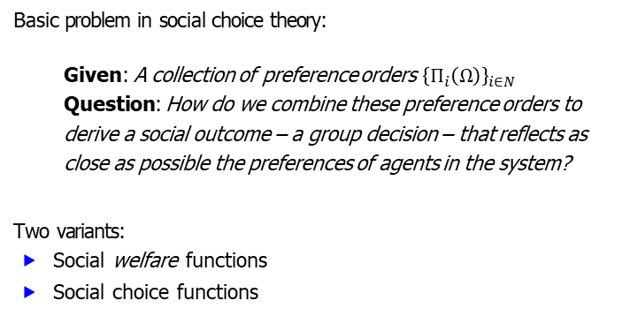
Aggregating preferences
Basic problem in social choice theory:
Given: A collection of preference orders ${\left\{Π_{i}\left(Ω\right)\right\}}_{i∈N}$
Question: How do we combine these preference orders to derive a social outcome – a group decision – that reflects as close as possible the preferences of agents in the system?
Two variants:
Social welfare functions
Social choice functions
10/9/2024
FIT5226-S2-2024
6/33
Notes:
Aggregating preferences is a fundamental problem in social choice theory, which deals with making collective decisions based on individual preferences. The basic problem can be described as follows:
Given: A collection of preference orders {Π𝑖(Ω)} for each agent 𝑖 in the set 𝑁.
Question: How do we combine these individual preference orders to derive a social outcome or group decision that best represents the preferences of all the agents in the system?
To tackle this problem, there are two common approaches or variants:
Social Welfare Functions: These functions aim to determine a social outcome or group preference order that reflects the collective preferences of the agents while considering various criteria, such as fairness and efficiency.
Social Choice Functions: These functions focus on identifying a specific alternative or outcome that will be selected as the group's choice based on the individual preferences of the agents. Social choice functions are concerned with selecting the most preferred option according to some predefined rules or criteria.
Both social welfare functions and social choice functions play essential roles in understanding and addressing the challenges of aggregating preferences in collective decision-making processes. These methods are used in contexts like voting systems, resource allocation, and public policy decision-making.

Slide 7
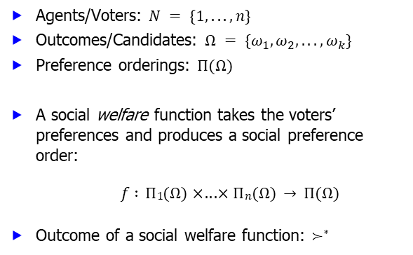
Social welfare functions
Agents/Voters: $N = \{1, . . . , n\}$
Outcomes/Candidates: $Ω = \{ω_{1}, ω_{2}, . . . , ω_{k}\}$
Preference orderings: $Π(Ω)$
A social welfare function takes the voters’ preferences and produces a social preference order:
$$f : Π1(Ω) × . . . × Πn(Ω) → Π(Ω)$$
Outcome of a social welfare function: $≻^{∗}$
10/9/2024
FIT5226-S2-2024
7/33
Notes:
In social choice theory, social welfare functions are used to determine a collective preference order or ranking of outcomes based on the individual preferences of agents or voters. Here are the key components of social welfare functions:
Agents/Voters: The set of agents or voters is denoted as 𝑁 = {1, 2, ..., 𝑛}, where 𝑛 represents the total number of agents participating in the decision-making process.
Outcomes/Candidates: The set of potential outcomes or candidates is represented as Ω = {𝜔₁, 𝜔₂, ..., 𝜔ₖ}, where 𝑘 is the total number of possible alternatives.
Preference Orderings: Each agent 𝑖 in 𝑁 has a preference ordering, Π𝑖(Ω), which specifies their ranked preferences over the outcomes in Ω. For example, Π₁(Ω) might represent the preference order of the first agent.
A social welfare function, denoted as 𝑓, takes the individual preference orderings of all agents (Π₁(Ω), Π₂(Ω), ..., Π𝑛(Ω)) and produces a social preference order, often denoted as $≻^{∗}$. This social preference order represents the collective ranking of outcomes that best captures the preferences of the entire group.
The social preference order $≻^{∗}$is determined by aggregating the individual preference orders based on some predefined rules or criteria. Social welfare functions are designed to address questions like "What is the collective ranking of outcomes that maximizes overall social welfare?" and aim to make group decisions that consider fairness, efficiency, and other societal values.

Slide 8
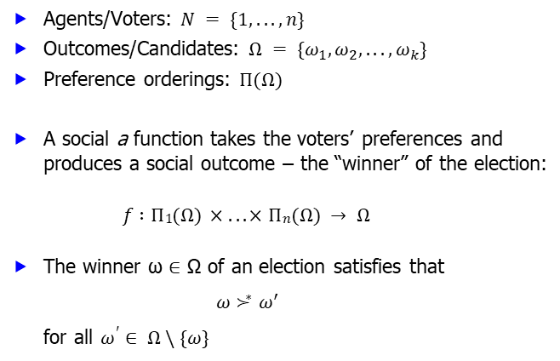
Social choice functions
Agents/Voters: $N = \{1, . . . , n\}$
Outcomes/Candidates: $Ω = \{ω_{1}, ω_{2}, . . . , ω_{k}\}$
Preference orderings: $Π(Ω)$
A social a function takes the voters’ preferences and produces a social outcome – the “winner” of the election:
$$f : Π1(Ω) × . . . × Πn(Ω) → Ω$$
The winner ω ∈ Ω of an election satisfies that
$$ω ≻^{∗} ω^{ ′ }$$
for all $ω^{′}∈ Ω \backslash \{ω\}$
10/9/2024
FIT5226-S2-2024
8/33
Notes:
In social choice theory, social choice functions are employed to determine the winning outcome or "winner" of an election based on the individual preferences of agents or voters. Here are the key components of social choice functions:
Agents/Voters: The set of agents or voters is represented as 𝑁 = {1, 2, ..., 𝑛}, where 𝑛 indicates the total number of agents participating in the election.
Outcomes/Candidates: The set of potential outcomes or candidates is defined as Ω = {𝜔₁, 𝜔₂, ..., 𝜔ₖ}, where 𝑘 is the total number of possible alternatives or candidates.
Preference Orderings: Each agent 𝑖 in 𝑁 has a preference ordering, Π𝑖(Ω), which specifies their ranked preferences over the outcomes in Ω.
A social choice function, denoted as 𝑓, takes the individual preference orderings of all agents (Π₁(Ω), Π₂(Ω), ..., Π𝑛(Ω)) and produces a social outcome, often represented by the "winner" ω, which is an element of Ω.
The winning outcome ω ∈ Ω is determined by the social choice function in such a way that it satisfies the condition:
$ω ≻^{∗} ω^{′}$
for all $ω^{′}$∈ Ω \ {𝜔}, meaning that the winning outcome ω is preferred to all other outcomes by a collective measure of the group's preferences.
Social choice functions aim to identify the outcome that best represents the collective choice of the group based on various aggregation methods and criteria, such as majority rule, ranked preference systems, and more. These functions play a crucial role in voting systems and decision-making processes, especially in elections and other scenarios involving multiple stakeholders.

Slide 9
Some ways/rules to choose a winner
Plurality
Plurality with elimination
Approval
Borda
Condorcet
Utilitarian
Egalitarian
Sequential majority
. . .
10/9/2024
FIT5226-S2-2024
9/33
Notes:
Certainly, there are various rules and methods to choose a winner in social choice theory, each with its own set of principles and considerations. Here's a brief overview of some of the methods you mentioned:
Plurality: The winner is the candidate who receives the most first-place votes, regardless of the majority. This method is simple and commonly used in many elections.
Plurality with Elimination: Candidates with the fewest first-place votes are successively eliminated, and the winner is determined by a series of run-off votes. This process continues until one candidate receives a majority of the votes.
Approval Voting: In this method, voters can "approve" or "disapprove" of each candidate. The winner is the candidate with the most approvals.
Borda Count: Each candidate receives points based on their rank in each voter's preference list. The candidate with the highest total score wins. This method considers the ranking of all candidates.
Condorcet Method: The Condorcet winner is the candidate who would win a one-on-one majority vote against every other candidate. If a Condorcet winner exists, they are declared the overall winner.
Utilitarian: The winner is determined based on maximizing overall utility or well-being for all voters. This approach considers the collective happiness or satisfaction of the group.
Egalitarian: This method aims to minimize inequality among voters. The winner is selected to reduce disparities in individual welfare.
Sequential Majority: In a sequence of votes, candidates are successively compared, and the one who consistently wins in pairwise comparisons becomes the winner.
These are just a few examples of rules and methods for choosing a winner in social choice theory. The choice of method depends on the specific context and the criteria that need to be considered, such as fairness, efficiency, and the type of preferences expressed by voters. Different rules may yield different outcomes, and selecting the most appropriate one is a fundamental challenge in social choice theory.

Slide 10
Plurality
Each candidate gets 1 vote for every preference order that ranks it first
The candidate with the largest number of votes wins
Very limited way of expressing preferences
It may require a tie-breaking rule
Example...
10/9/2024
FIT5226-S2-2024
10/33
Notes:
Each candidate gets 1 vote for every preference order in which it is ranked first. This means that voters express their preference by selecting their top choice, and each candidate accumulates votes based on how often they are ranked first.
The candidate with the largest number of votes wins. In a Plurality system, the winner is the candidate who receives the most first-place votes, even if they do not have an overall majority of the votes.
It offers a very limited way of expressing preferences. Plurality only considers the top choice of voters and does not take into account their preferences for other candidates. This simplicity can be an advantage for some elections but may not capture the nuances of voters' preferences.
It may require a tie-breaking rule. When two or more candidates receive the same number of first-place votes, a tie-breaking rule is necessary to determine the winner. Common tie-breakers include considering the second-choice votes or using a random draw.
Plurality is often used in various elections, such as political elections in some countries, but it has its limitations, including its inability to represent more detailed voter preferences.

Slide 11
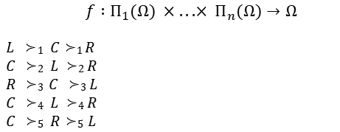
Example: Plurality
Agents/Voters: N = {1, 2, 3, 4, 5}
Outcomes/Candidates: Ω = {L, C, R}
Preference orderings: Π(Ω)
Social choice function:
$$f : Π_{1}(Ω) × . . . × Π_{n}(Ω)→Ω$$
$L ≻1 C≻1 R$
$C ≻2 L ≻2 R$
$R ≻3 C ≻3 L$
$C ≻4 L ≻4 R$
$C ≻5 R≻5 L$
Social outcome $($the $“$winner$”):$ $C$
10/9/2024
FIT5226-S2-2024
11/33
Notes:
In this example of the Plurality method:
There are 5 voters, numbered from 1 to 5.
There are 3 outcomes (candidates): Left (L), Center (C), and Right (R).
Each voter has a preference ordering Π(Ω) that represents their ranking of the candidates.
For instance, voter 1 (represented by $Π_{1}$) prefers Left (L) over Center (C) and Right (R). The preferences of all agents are shown in a similar manner.
The social choice function 𝑓 takes the preferences of all agents and produces a social outcome.
The outcome of this Plurality election is "C" (Center). This is because "C" received the most first-place votes. Even though other candidates may have been ranked first by some agents, "C" received the highest number of first-place votes, making it the winner.
In Plurality, the winner is determined solely based on the number of first-place votes each candidate receives, which in this case is "C."

Slide 12
Plurality with elimination
Each candidate gets 1 vote for every preference order it as first
The candidate with the fewest number of votes is eliminated
Voters who get their top candidate eliminated cast a new vote
The process continues until a single candidate is left
It may require tie-breaking rules
Example...
10/9/2024
FIT5226-S2-2024
12/33
Notes:
Plurality with elimination is an alternative voting method that involves several steps:
Each candidate initially receives 1 vote for every preference order in which they are ranked first by a voter.
The candidate with the fewest votes is eliminated from the race.
Voters who had their top candidate eliminated cast a new vote, taking into account the remaining candidates.
This process of elimination and re-voting continues until only one candidate remains.
In some cases, tie-breaking rules may be necessary to determine which candidate is eliminated when there is a tie in the number of votes.
Plurality with elimination is a more involved voting method compared to simple Plurality, as it allows voters to re-cast their votes after their preferred candidates are eliminated. This process continues until a single candidate emerges as the winner, making it a more comprehensive way to determine the ultimate choice of the voters.

Slide 13
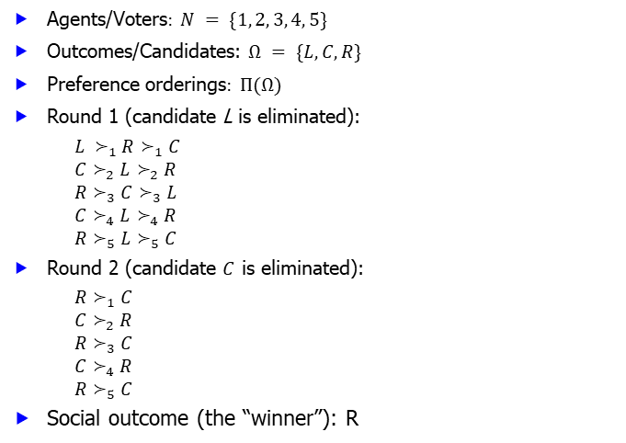
Example: Plurality with elimination
Agents/Voters$: N = \{1, 2, 3, 4, 5\}$
Outcomes/Candidates: $Ω = \{L, C, R\}$
Preference orderings$: Π(Ω)$
Round 1 (candidate L is eliminated):
$L ≻_{1}R≻_{1}C$
$C≻_{2}L≻_{2}R$
$R≻_{3}C≻_{3}L$
$C≻_{4}L≻_{4}R$
$R≻_{5}L≻_{5}C$
Round 2 (candidate $C$ is eliminated):
$R≻_{1}C$
$C≻_{2}R$
$R≻_{3}C$
$C≻_{4}R$
$R≻_{5}C$
Social outcome (the “winner”): R
10/9/2024
FIT5226-S2-2024
13/33
Notes:
Example: Plurality with elimination
In this example, we have 5 agents/voters, 3 candidates, and their preference orderings:
Agents/Voters: 𝑁 = {1, 2, 3, 4, 5}
Outcomes/Candidates: Ω = {𝐿, 𝐶, 𝑅}
Preference orderings: Π(Ω)
The voting process unfolds in two rounds:
Round 1 (candidate L is eliminated):
Voter 1: 𝐿 ≻ 𝑅 ≻ 𝐶
Voter 2: 𝐶 ≻ 𝐿 ≻ 𝑅
Voter 3: 𝑅 ≻ 𝐶 ≻ 𝐿
Voter 4: 𝐶 ≻ 𝐿 ≻ 𝑅
Voter 5: 𝑅 ≻ 𝐿 ≻ 𝐶
After this round, candidate L has the fewest votes and is eliminated.
Round 2 (candidate 𝐶 is eliminated):
Voter 1: 𝑅 ≻ 𝐶
Voter 2: 𝐶 ≻ 𝑅
Voter 3: 𝑅 ≻ 𝐶
Voter 4: 𝐶 ≻ 𝑅
Voter 5: 𝑅 ≻ 𝐶
Following the elimination of candidate C, the process concludes, and the social outcome (the "winner") is candidate R.
Plurality with elimination is a voting method that progressively narrows down the choices, allowing voters to reconsider their preferences as candidates are eliminated. In this case, candidate R is the ultimate winner.

Slide 14
Approval voting
Each “approved” candidate gets 1 vote; other candidates get 0
The candidate with the largest number of votes wins
It may require a tie-breaking rule
Example...
10/9/2024
FIT5226-S2-2024
14/33
Notes:
Approval voting is a relatively straightforward voting method:
In approval voting, each voter can "approve" one or more candidates by giving them a vote. All other candidates receive 0 votes from that voter.
The candidate who receives the most votes (approvals) is declared the winner.
In the case of a tie, a tie-breaking rule may be necessary to determine the winner.
Approval voting allows voters to express their support for multiple candidates simultaneously, potentially leading to a more representative outcome. It is a simple yet effective way to gauge preferences in a multi-candidate election.

Slide 15
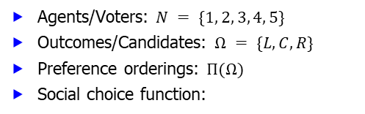

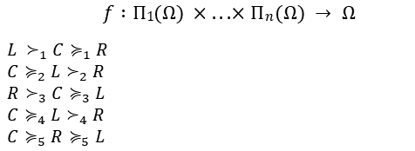
Example: Approval voting
Agents/Voters: $N = \{1, 2, 3, 4, 5\}$
Outcomes/Candidates: $Ω = \{L, C, R\}$
Preference orderings: $Π(Ω)$
Social choice function:
$$f : Π1(Ω) × . . . × Πn(Ω) → Ω$$
$L ≻_{1}C≽_{1}R$
$C≽_{2}L≻_{2}R$
$R≻_{3}C≽_{3}L$
$C≽_{4}L≻_{4}R$
$C≽_{5}R≽_{5}L$
Social outcome (the “winner”): $L$ Here, if $ω≻_{i}ω′$, then $ω$is approved and $ω^{′ }$is not; and, if$ω≽_{i}ω′$, then both candidates are approved/not approved.
10/9/2024
FIT5226-S2-2024
15/33
Notes:
In the example of Approval voting:
Agents/Voters: 𝑁 = {1, 2, 3, 4, 5}
Outcomes/Candidates: Ω = {𝐿, 𝐶, 𝑅}
Preference orderings: Π(Ω)
The social choice function 𝑓 takes into account the approvals of each voter and produces a social outcome (the "winner"). In Approval voting, each voter can approve (give a vote to) one or more candidates:
$L≻_{1}C≽_{1}R$(Voter 1 approves L, does not approve C and R)
$C≽_{2}L≻_{2}R$(Voter 2 approves C and L, does not approve R)
$R≻_{3}C≽_{3}L$(Voter 3 approves R, does not approve C and L)
$C≽_{4}L≻_{4}R$(Voter 4 approves C and L, does not approve R)
$C≽_{5}R≽_{5}L$(Voter 5 approves C, R, and L)
In this example, the candidate L has the most approvals, making it the "winner" of the election in the context of Approval voting.
| L | C | R
-----------------------------
| 1 | 0 | 0
-----------------------------
2 | 1 | 1 | 0
-----------------------------
3 | 0 | 0 | 1
-----------------------------
4 | 1 | 1 | 0
-----------------------------
5 | 1 | 1 | 1
-----------------------------
Tot | 4 | 3 | 2

Slide 16
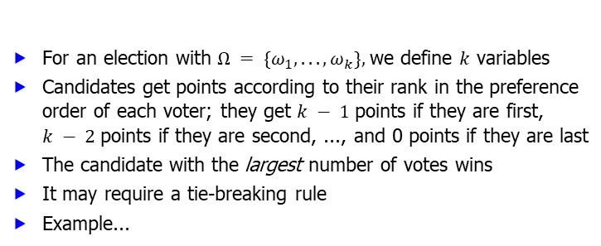
Borda count
For an election with $Ω = \{ω_{1}, . . . , ω_{k}\},$we define $k$ variables
Candidates get points according to their rank in the preference order of each voter; they get $k − 1$points if they are first, $k − 2$points if they are second, ..., and 0 points if they are last
The candidate with the largest number of votes wins
It may require a tie-breaking rule
Example...
10/9/2024
FIT5226-S2-2024
16/33
Notes:
The Borda count is a voting method used in social choice theory. Here's how it works:
For an election with 𝑘 candidates $Ω = \{ω_{1}, . . . , ω_{k}\}$, 𝑘 variables are defined.
Candidates receive points based on their rank in the preference order of each voter. Specifically, candidates receive 𝑘 − 1 points if they are ranked first, 𝑘 − 2 points if they are ranked second, and so on, down to 0 points if they are ranked last.
The candidate with the largest number of points, often referred to as the Borda score, is declared the winner.
In situations where there is a tie, a tie-breaking rule may be needed to determine the winner.
The Borda count is a ranked voting system that takes into account not only voters' preferences but also the order in which candidates are ranked in those preferences. It aims to find a consensus candidate by considering the rankings from all voters.

Slide 17


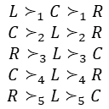
Example: Borda count
Agents/Voters: $N = \{1, 2, 3, 4, 5\}$
Outcomes/Candidates: $Ω = \{L, C, R\}$
$$L≻_{1}C≻_{1}R$$
$$C≻_{2}L≻_{2}R$$
$$R≻_{3}L≻_{3}C$$
$$C≻_{4}L≻_{4}R$$
$$R≻_{5}L≻_{5}C$$
$v_{L}=6; v_{C}= 5; v_{R}= 4$
Social outcome (the “winner”): $L$
10/9/2024
FIT5226-S2-2024
17/33
Notes:
In this example of the Borda count, we have five voters and three candidates: Ω = {𝐿, 𝐶, 𝑅}. Each voter has their own preference order, and candidates are ranked within those preferences. The Borda count assigns points to candidates based on their rank in each voter's preference order:
| L | C | R
-----------------------------
| 2 | 1 | 0
-----------------------------
2 | 1 | 2 | 0
-----------------------------
3 | 1 | 0 | 2
-----------------------------
4 | 1 | 2 | 0
-----------------------------
5 | 1 | 0 | 2
-----------------------------
Tot | 6 | 5 | 4
The Borda score for each candidate is the sum of the points they receive from all voters. In this case:
𝐿 receives 6 points.
𝐶 receives 5 points.
𝑅 receives 4 points.
Therefore, the social outcome (the "winner") according to the Borda count is candidate 𝐿, as it has the highest Borda score. This demonstrates how the Borda count considers the rankings from all voters to determine the winner.

Slide 18
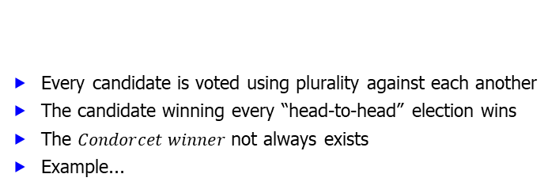
Condorcet rule
Every candidate is voted using plurality against each another
The candidate winning every “head-to-head” election wins
The $Condorcet winner$not always exists
Example...
One-vs-one
10/9/2024
FIT5226-S2-2024
18/33
Notes:
The Condorcet rule is a method for choosing a winner in an election that involves a head-to-head comparison of candidates. Here are the key features of the Condorcet rule:
Head-to-Head Elections: In the Condorcet rule, every candidate is pitted against each other in a series of head-to-head elections. This means that for each pair of candidates, voters express their preferences, and a winner is determined in these one-on-one matchups.
The Condorcet Winner: The Condorcet winner is the candidate who, when compared to every other candidate individually, wins in a head-to-head election. In other words, a Condorcet winner is a candidate who would beat all other candidates if they were considered in separate two-candidate races.
Not Always Existing: It's important to note that a Condorcet winner may not always exist in an election. In some cases, there might be no single candidate who can beat every other candidate in a head-to-head election. This can happen when voter preferences are not transitive, leading to cycles where A beats B, B beats C, and C beats A.
The Condorcet rule aims to select a candidate who has majority support when compared to every other candidate individually. However, in cases where there is no clear Condorcet winner due to cycles in preferences, alternative methods or tie-breaking rules may be needed to determine the election's outcome.

Slide 19
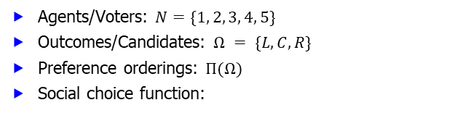

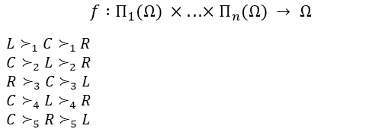
Example: Condorcet rule
Agents/Voters: $N=\{1, 2, 3, 4, 5\}$
Outcomes/Candidates: $Ω = \{L, C, R\}$
Preference orderings: $Π(Ω)$
Social choice function:
$$f : Π_{1}(Ω) × . . . × Π_{n}(Ω) → Ω$$
$L≻_{1}C≻_{1}R$
$C≻_{2}L≻_{2}R$
$R≻_{3}C≻_{3}L$
$C≻_{4}L≻_{4}R$
$C≻_{5}R≻_{5}L$
Social outcome (the “winner”): $C$
10/9/2024
FIT5226-S2-2024
19/33
Notes:
In this example of the Condorcet rule, we have five agents (voters) and three candidates (outcomes). The preference orderings of the agents are as follows:
Voter 1 prefers 𝐿, then 𝐶, and finally 𝑅.
Voter 2 prefers 𝐶, then 𝐿, and finally 𝑅.
Voter 3 prefers 𝑅, then 𝐶, and finally 𝐿.
Voter 4 prefers 𝐶, then 𝐿, and finally 𝑅.
Voter 5 prefers 𝐶, then 𝑅, and finally 𝐿.
Using these preference orderings, the social choice function determines the Condorcet winner by conducting head-to-head elections between the candidates.
| L | C | | C | R | | L | R |
--------------- --------------- ---------------
| 1 | 0 | 1 | 1 | 0 | 1 | 1 | 0 |
--------------- --------------- ---------------
2 | 0 | 1 | 2 | 1 | 0 | 2 | 1 | 0 |
--------------- --------------- ---------------
3 | 0 | 1 | 3 | 0 | 1 | 3 | 0 | 1 |
--------------- --------------- ---------------
4 | 0 | 1 | 4 | 1 | 0 | 4 | 1 | 0 |
--------------- --------------- ---------------
5 | 0 | 1 | 5 | 1 | 0 | 5 | 0 | 1 |
--------------- --------------- ---------------
Tot | 1 | 4 | Tot | 4 | 1 | Tot | 3 | 2 |
The result is that 𝐶 emerges as the Condorcet winner because it beats both 𝐿 and 𝑅 when compared in individual head-to-head matchups. Therefore, 𝐶 is selected as the social outcome (the "winner") based on the Condorcet rule.

Slide 20
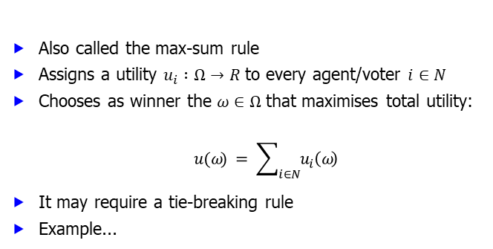
Utilitarian rule
Also called the max-sum rule
Assigns a utility $u_{i} :Ω→R$to every agent/voter $i∈N$
Chooses as winner the $ω∈Ω$that maximises total utility:
$$u(ω) = \sum_{i∈N}{u_{i}\left(ω\right)}$$
It may require a tie-breaking rule
Example...
10/9/2024
FIT5226-S2-2024
20/33
Notes:
The utilitarian rule, sometimes referred to as the max-sum rule, is a social choice function that aims to maximize the total utility among all agents or voters. Here's how it works:
Each agent or voter, denoted as 𝑖∈𝑁, assigns a utility function 𝑢_i(𝜔) to every candidate or outcome 𝜔∈Ω. This utility function represents the desirability of 𝜔 from the perspective of agent 𝑖.
The social choice function computes the total utility for each candidate 𝜔 by summing up the utilities assigned by all agents: $u(ω) = \sum_{i∈N}{u_{i}\left(ω\right)}$.
The candidate 𝜔 that maximizes the total utility 𝑢(𝜔) is chosen as the winner according to the utilitarian rule.
It's important to note that the utilitarian rule may require a tie-breaking mechanism in cases where multiple candidates have the same maximum total utility. This rule is focused on selecting the candidate that collectively maximizes the overall well-being or utility of the agents in the system.

Slide 21


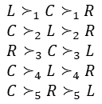
Example: Utilitarian rule
Agents/Voters: $N=\{1, 2, 3, 4, 5\}$
Outcomes/Candidates: $Ω=\{L, C, R\}$
Assume that $u_{i}$ gives utilities as the Borda count method.
$L≻_{1}C≻_{1}R$
$C≻_{2}L≻_{2}R$
$R≻_{3}C≻_{3}L$
$C≻_{4}L≻_{4}R$
$$C≻_{5}R≻_{5}L$$
$u(L)=4; u(C )=8; u(R)=3$
Social outcome (the “winner”): $C$
10/9/2024
FIT5226-S2-2024
21/33
Notes:
In the example of the Utilitarian rule:
Agents/Voters: 𝑁={1, 2, 3, 4, 5}
Outcomes/Candidates: Ω={𝐿, 𝐶, 𝑅}
Assuming that 𝑢_𝑖 gives utilities as the Borda count method, the preference orders and utilities assigned by each agent are as follows:
| L | C | R
-----------------------------
| 2 | 1 | 0
-----------------------------
2 | 1 | 2 | 0
-----------------------------
3 | 0 | 1 | 2
-----------------------------
4 | 1 | 2 | 0
-----------------------------
5 | 0 | 2 | 1
-----------------------------
Tot | 4 | 8 | 3
Now, the Utilitarian rule calculates the total utility for each candidate:
$u(L)=∑u_{i}(L)$= 2 + 1 + 0 + 1 + 0 = 4
$u(C)=∑u_{i}(C)$= 1 + 2 + 1 + 2 + 2 = 8
$u(R)=∑u_{i}(R)$= 0 + 0 + 2 + 0 + 1 = 3
The candidate 𝐶 has the highest total utility, and therefore, according to the Utilitarian rule, 𝐶 is chosen as the social outcome (the "winner").

Slide 22
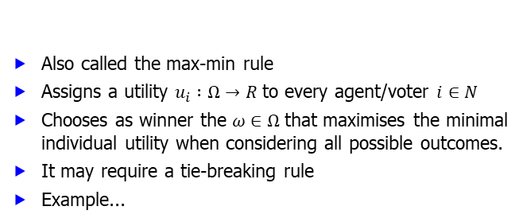
Egalitarian rule
Also called the max-min rule
Assigns a utility $u_{i} :Ω→R$to every agent/voter $i∈N$
Chooses as winner the $ω∈Ω$that maximises the minimal individual utility when considering all possible outcomes.
It may require a tie-breaking rule
Example...
10/9/2024
FIT5226-S2-2024
22/33
Notes:
The Egalitarian rule, also known as the max-min rule, aims to maximize the minimal individual utility among all agents/voters. Here's how it works:
For each agent/voter 𝑖∈𝑁, a utility function $u_{i}$: Ω → 𝑅 is assigned. This utility function represents the preferences and values of each agent for the outcomes/candidates.
The Egalitarian rule then considers all possible outcomes/candidates 𝜔∈Ω and calculates the minimal individual utility for each outcome by finding the minimum $u_{i}\left(ω\right)$over all agents 𝑖∈𝑁.
The outcome 𝜔 that maximizes this minimal individual utility is chosen as the winner according to the Egalitarian rule.
This rule aims to ensure that even the agent with the lowest utility (i.e., the one with the least preferred outcome) receives the highest possible utility among all outcomes. It focuses on achieving fairness and equitable results in the decision-making process.
Like other social choice rules, the Egalitarian rule may require a tie-breaking mechanism in case multiple outcomes have the same maximal minimal individual utility.

Slide 23
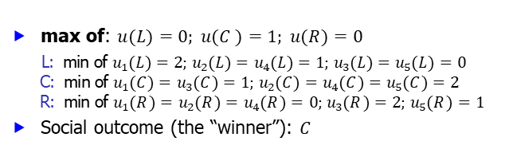
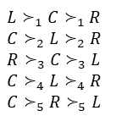
Example: Egalitarian rule
Agents/Voters: $N=\{1, 2, 3, 4, 5\}$
Outcomes/Candidates: $Ω=\{L, C, R\}$
Assume that $u_{i}$ gives utilities as the Borda count method.
$L≻_{1}C≻_{1}R$
$$C≻_{2}L≻_{2}R$$
$R≻_{3}C≻_{3}L$
$$C≻_{4}L≻_{4}R$$
$$C≻_{5}R≻_{5}L$$
max of: $u(L)=0; u(C )=1; u(R)=0$
L: min of $u_{1}(L)=2; u_{2}(L)=u_{4}(L)=1; u_{3}(L)=u_{5}(L)=0$ C: min of $u_{1}(C )=u_{3}(C )=1; u_{2}(C )=u_{4}(C )=u_{5}(C )=2$ R: min of $u_{1}(R)=u_{2}(R)=u_{4}(R)=0; u_{3}(R)=2; u_{5}(R)=1$
Social outcome (the “winner”): $C$
10/9/2024
FIT5226-S2-2024
23/33
Notes:
The Egalitarian rule aims to maximize the minimal individual utility among all agents/voters. In this example:
Agents/Voters: 𝑁 = {1, 2, 3, 4, 5}
Outcomes/Candidates: Ω = {𝐿, 𝐶, 𝑅}
Assume that the utility functions 𝑢_𝑖 are assigned based on the Borda count method, where higher-ranked candidates receive more points according to the Borda count rules.
For each candidate (𝐿, 𝐶, 𝑅), we calculate the minimal individual utility among all agents:
For candidate 𝐿: The minimal utility is 0, which is the minimum of individual utilities for 𝐿.
For candidate 𝐶: The minimal utility is 1, which is the minimum of individual utilities for 𝐶.
For candidate 𝑅: The minimal utility is 0, which is the minimum of individual utilities for 𝑅.
| L | C | R
-----------------------------
| 2 | 1 | 0
-----------------------------
2 | 1 | 2 | 0
-----------------------------
3 | 0 | 1 | 2
-----------------------------
4 | 1 | 2 | 0
-----------------------------
5 | 0 | 2 | 1
-----------------------------
Min | 0 | 1 | 0
Among these candidates, candidate 𝐶 has the highest minimal individual utility, making it the winner according to the Egalitarian rule. This rule prioritizes candidates that provide the best outcome for the agent with the lowest utility while still considering the preferences of all agents.

Slide 24
Sequential majority
Another variant of plurality, played in a series of rounds
Rounds form linear or tree-like sequences (tournaments)
In each round a pair-wise plurality election takes place
The candidate that wins continues in the contest
The process continues until a single candidate is left
It may require a tie-breaking rule
Example...
10/9/2024
FIT5226-S2-2024
24/33
Notes:
Sequential majority is a voting system that involves a series of rounds, forming linear or tree-like sequences known as tournaments. In each round of this system, a pair-wise plurality election is held among the remaining candidates. The candidate who wins this pair-wise election continues in the contest, while the losing candidate is eliminated. The process continues through subsequent rounds until only a single candidate remains as the winner. Sequential majority may require a tie-breaking rule in the case of a draw or uncertainty in any of the rounds. This method allows for a step-by-step elimination of candidates, helping to identify a single winning candidate through a sequence of pair-wise elections.

Slide 25
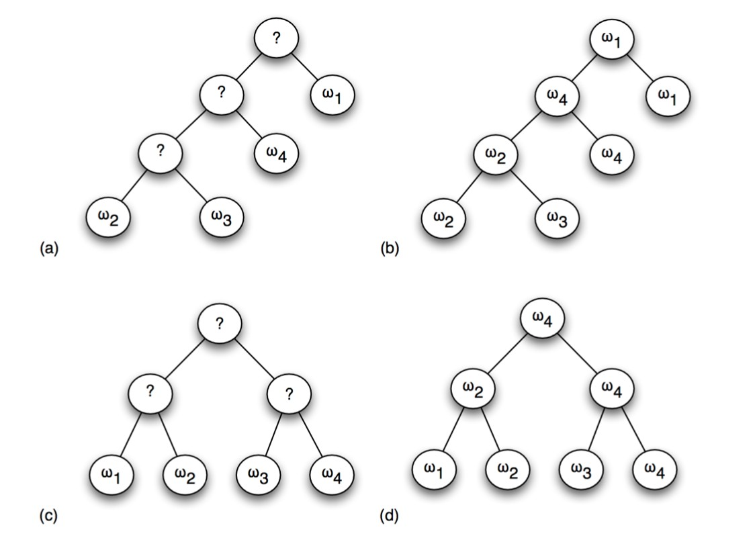


Example: Sequential majority
Agents/Voters: $N=\{1, 2, 3\}$
Outcomes/Candidates: $Ω=\{ω_{1}, ω_{2}, ω_{3}, ω_{4}\}$
$$ω_{4}≻_{1}ω_{2}≻_{1}ω_{3}≻_{1}ω_{1}$$
$$ω_{1}≻_{2}ω_{4}≻_{2}ω_{2}≻_{2}ω_{3}$$
$$ω_{2}≻_{3}ω_{3}≻_{3}ω_{1}≻_{3}ω_{4}$$
Plurality
Plurality
Balanced Binary Tree
10/9/2024
FIT5226-S2-2024
25/33
Notes:
In the given example of Sequential Majority, there are three agents/voters (N = {1, 2, 3) and four potential outcomes/candidates (Ω = $\{ω_{1}, ω_{2}, ω_{3}, ω_{4}\}$). Here are the preference orderings for the agents:
Voter 1: $ω_{4} ≻ ω_{2} ≻ ω_{3} ≻ ω_{1}$
Voter 2: $ω_{1} ≻ ω_{4} ≻ ω_{2} ≻ ω_{3}$
Voter 3: $ω_{2} ≻ ω_{3} ≻ ω_{1} ≻ ω_{4}$
Now, let's determine the outcome through Sequential Majority rounds.
Upper Example:
Round 1: Voters vote for $ω_{2}$ vs $ω_{3}$, candidate $ω_{2}$ wins (use plurality)
Round 2: Voters vote for $ω_{2}$ vs $ω_{4}$, candidate $ω_{4}$ wins
Round 3: Voters vote for $ω_{4}$ vs $ω_{1}$, candidate $ω_{1}$ wins
The winner is $ω_{1}$
Lower Example:
Round 1-1: Voters vote for $ω_{1}$ vs $ω_{2}$, candidate $ω_{2}$ wins
Round 1-2: Voters vote for $ω_{3}$ vs $ω_{4}$, candidate $ω_{4}$ wins
Round 2: Voters vote for $ω_{4}$ vs $ω_{4}$, candidate $ω_{4}$ wins
The winner is $ω_{4}$

Slide 26
Paradoxes, desirable and undesirable properties
The majority of the society should not prefer another outcome
The outcome should not be determined by the “agenda”
Removing a losing candidate should not affect the outcome
The outcome should not be determined by a single agent
Pareto efficient
Independence of irrelevant choices
10/9/2024
FIT5226-S2-2024
26/33
Notes:
These are some of the key properties and principles in social choice theory:
Majority Criterion: The majority of the society should not prefer another outcome. In other words, if a candidate has the majority of first-place votes, they should be the winner.
Independence of Irrelevant Alternatives: Removing a losing candidate should not affect the outcome. This principle ensures that the addition or removal of a candidate who cannot win should not change the result among the remaining candidates.
Non-Dictatorship: The outcome should not be determined by a single agent, known as a dictator. No single voter's preferences should solely determine the group decision.
Pareto Efficiency: The chosen outcome should be at least as good as every other outcome for every voter. In other words, if everyone prefers candidate A to candidate B, then the collective choice should also prefer A to B.
Independence of Irrelevant Choices: The outcome should not be influenced by irrelevant choices. This means that the relative ranking of two candidates should not be affected by how they are ranked in comparison to other candidates.
These properties help guide the design of fair and effective voting systems and are essential for ensuring desirable outcomes in collective decision-making. However, it's important to note that achieving all of these properties simultaneously can be challenging, and some properties may conflict with others in certain situations, leading to paradoxes. Social choice theory aims to explore the trade-offs and challenges in designing fair and robust voting systems.

Slide 27
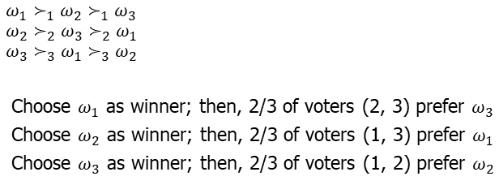
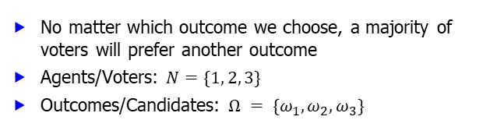
Condorcet’s paradox
No matter which outcome we choose, a majority of voters will prefer another outcome
Agents/Voters: $N=\{1, 2, 3\}$
Outcomes/Candidates: $Ω = \{ω_{1}, ω_{2}, ω_{3}\}$
$ω_{1}≻_{1}ω_{2}≻_{1}ω_{3}$ $ω_{2}≻_{2}ω_{3}≻_{2}ω_{1}$ $ω_{3}≻_{3}ω_{1}≻_{3}ω_{2}$
Choose $ω_{1}$ as winner; then, 2/3 of voters (2, 3) prefer $ω_{3}$
Choose $ω_{2}$ as winner; then, 2/3 of voters (1, 3) prefer $ω_{1}$
Choose $ω_{3}$ as winner; then, 2/3 of voters (1, 2) prefer $ω_{2}$
10/9/2024
FIT5226-S2-2024
27/33
Notes:
Condorcet's paradox is a fascinating paradox in social choice theory, demonstrating how the outcome of a ranked-choice election can be highly dependent on the chosen method and lead to seemingly contradictory results. In this example, we have:
Three voters: 1, 2, and 3.
Three candidates: $ω_{1}$, $ω_{2}$, and $ω_{3}$.
Each voter has their own preference order, as you described:
Voter 1 prefers $ω_{1}≻ω_{2}≻ω_{3}$.
Voter 2 prefers $ω_{2}≻ω_{3}≻ω_{1}$.
Voter 3 prefers $ω_{3}≻ω_{1}≻ω_{2}$.
When different winners are chosen based on the Condorcet method (where each candidate is voted on in a head-to-head matchup), we see the paradox:
If $ω_{1}$is chosen, then 2 out of 3 voters (2 and 3) prefer $ω_{3}$.
If $ω_{2}$is chosen, then 2 out of 3 voters (1 and 3) prefer $ω_{1}$.
If $ω_{3}$is chosen, then 2 out of 3 voters (1 and 2) prefer $ω_{2}$.
This paradox highlights the challenges and complexities of aggregating individual preferences into a collective choice. It demonstrates that different methods of choosing a winner can lead to very different outcomes, even when preferences remain consistent.
Condorcet's paradox is one of the classic paradoxes in social choice theory and illustrates the difficulties in designing fair and consistent voting systems.

Slide 28

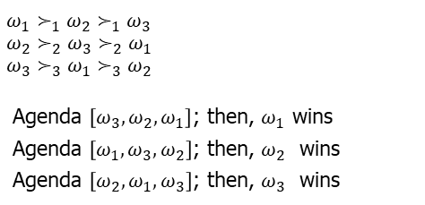
Manipulation of the outcome: The agenda
For every candidate, we may be able to fix an agenda for that candidate to win in a sequential majority election
Agents/Voters: $N=\{1, 2, 3\}$
Outcomes/Candidates: $Ω=\{ω_{1}, ω_{2}, ω_{3}\}$
$ω_{1}≻_{1}ω_{2}≻_{1}ω_{3}$ $ω_{2}≻_{2}ω_{3}≻_{2}ω_{1}$ $ω_{3}≻_{3}ω_{1}≻_{3}ω_{2}$
Agenda $\left[ω_{3},ω_{2},ω_{1}\right]$; then, $ω_{1}$ wins
Agenda $\left[ω_{1},ω_{3},ω_{2}\right]$; then, $ω_{2}$ wins
Agenda $\left[ω_{2},ω_{1},ω_{3}\right]$; then, $ω_{3}$ wins
10/9/2024
FIT5226-S2-2024
28/33
Notes:
This example demonstrates how the agenda, or the order in which candidates are considered in a sequential majority election, can be manipulated to determine the outcome. Here's how it works:
Agents/Voters: 𝑁 = {1, 2, 3}
Outcomes/Candidates: Ω = {$ω_{1}, ω_{2}, ω_{3}$}
Each voter has their own preference order, as you described:
Voter 1 prefers $ω_{1}≻ω_{2}≻ω_{3}$.
Voter 2 prefers $ω_{2}≻ω_{3}≻ω_{1}$.
Voter 3 prefers $ω_{3}≻ω_{1}≻ω_{2}$.
Now, consider different agendas (orders in which candidates are considered) for the sequential majority election:
Agenda [$ω_{3}, ω_{2}, ω_{1}$]: In this case, $ω_{3}$is considered first, and $ω_{3}$wins.
Agenda [$ω_{1}, ω_{3}, ω_{2}$]: In this case, $ω_{1}$is considered first, and $ω_{2}$wins.
Agenda [$ω_{2}, ω_{1}, ω_{3}$]: In this case, $ω_{2}$is considered first, and $ω_{3}$wins.
This example illustrates how the agenda-setting can be manipulated to produce different outcomes, emphasizing the importance of agenda control in sequential majority elections. It's one of the challenges in designing fair and robust voting systems to prevent strategic manipulation.

Slide 29
Sensitivity to a losing candidate
Agents/Voters: $N=\{1, 2, 3\}$
Outcomes/Candidates: $Ω=\{ω_{1}, ω_{2}, ω_{3}, ω_{4}\}$
$$ω_{4}≻_{1}ω_{2}≻_{1}ω_{3}≻_{1}ω_{1}$$
$$ω_{1}≻_{2}ω_{4}≻_{2}ω_{2}≻_{2}ω_{3}$$
$$ω_{2}≻_{3}ω_{3}≻_{3}ω_{1}≻_{3}ω_{4}$$
10/9/2024
FIT5226-S2-2024
29/33

Slide 30
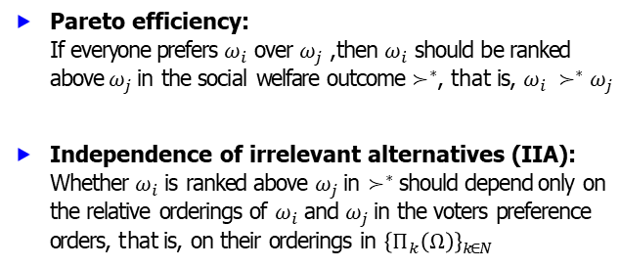
Pareto efficiency & independence of irrelevant alternatives
Pareto efficiency: If everyone prefers $ω_{i}$ over $ω_{j}$, then $ω_{i}$ should be ranked above $ω_{j}$ in the social welfare outcome $≻^{∗}$, that is, $ω_{i} ≻^{∗}ω_{j}$
Independence of irrelevant alternatives (IIA): Whether $ω_{i}$is ranked above $ω_{j}$ in $≻^{∗}$should depend only on the relative orderings of $ω_{i}$and $ω_{j}$in the voters preference orders, that is, on their orderings in ${\left\{Π_{k}\left(Ω\right)\right\}}_{k∈N}$
10/9/2024
FIT5226-S2-2024
30/33
Notes:
Pareto efficiency and independence of irrelevant alternatives are fundamental concepts in social choice theory.
Pareto efficiency: This principle suggests that if everyone in a group or society prefers one outcome ($ω_{i}$) over another ($ω_{j}$), then the social welfare outcome ($≻^{∗}$) should reflect this preference by ranking $ω_{i}$ above $ω_{j}$. In other words, if there is a clear preference for $ω_{i}$ over $ω_{j}$ among all individuals, the social choice should respect this preference.
Independence of irrelevant alternatives (IIA): This principle emphasizes that whether $ω_{i}$ is ranked above $ω_{j}$ in the social welfare outcome ($≻^{∗}$) should depend solely on the relative orderings of $ω_{i}$ and $ω_{j}$ in the voters' preference orders. In other words, the outcome should not be influenced by the inclusion or exclusion of other alternatives. The relative ranking of $ω_{i}$ and $ω_{j}$ should be determined by the preferences of the voters and should remain consistent regardless of other available alternatives.
These principles are essential for ensuring fairness and rationality in collective decision-making processes and are key criteria for evaluating the performance of different social choice functions and voting systems.

Slide 31
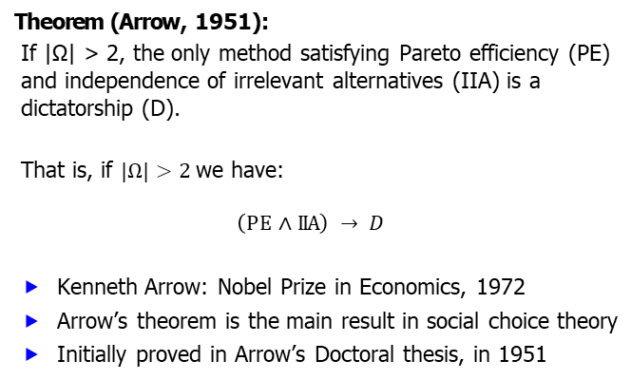
Arrow’s theorem
Theorem (Arrow, 1951):
If |Ω| > 2, the only method satisfying Pareto efficiency (PE) and independence of irrelevant alternatives (IIA) is a dictatorship (D).
That is, if $|Ω|>2$we have:
$$\left(PE∧ IIA\right) → D$$
Kenneth Arrow: Nobel Prize in Economics, 1972
Arrow’s theorem is the main result in social choice theory
Initially proved in Arrow’s Doctoral thesis, in 1951
10/9/2024
FIT5226-S2-2024
31/33
Notes:
Arrow's theorem, formulated by Kenneth Arrow, is a fundamental result in social choice theory. It states that if the set of alternatives (Ω) contains more than two options (|Ω| > 2), and a decision-making method satisfies both Pareto efficiency (PE) and independence of irrelevant alternatives (IIA), then the only outcome produced by this method is a dictatorship (D).
In other words, Arrow's theorem reveals that in a setting with three or more alternatives, it is impossible to design a fair and rational social choice function that consistently respects Pareto efficiency and independence of irrelevant alternatives. Instead, the only method that can satisfy these conditions is a dictatorship, where a single individual's preferences dictate the outcome.
Kenneth Arrow's work on this theorem was groundbreaking and earned him the Nobel Prize in Economics in 1972. Arrow's theorem highlights the inherent challenges and limitations in designing collective decision-making systems that meet certain desirable criteria, and it has significant implications for fields such as political science and economics. The theorem was initially presented in Arrow's doctoral thesis in 1951 and continues to be a cornerstone in the study of social choice and voting theory.

Slide 32
References
Some suggested readings:
Yoav Shoham and Kevin Leyton-Brown. Multiagent Systems: Algorithmic, Game-Theoretic, and Logical Foundations. Chapter 9, Cambridge University Press, 2008.
Michael Wooldridge. An Introduction to MultiAgent Systems. Chapter 12, Wiley, 2009.
10/9/2024
FIT5226-S2-2024
32/33

Slide 33
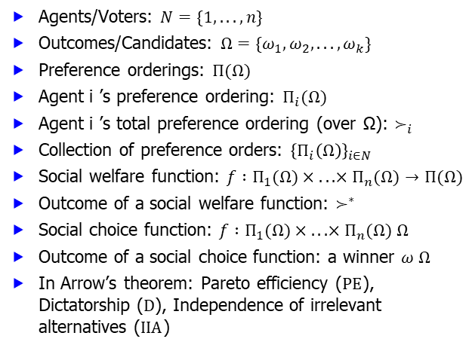
Summary of notations
Agents/Voters: $N=\{1, . . . , n\}$
Outcomes/Candidates: $Ω=\{ω_{1}, ω_{2}, . . . , ω_{k}\}$
Preference orderings: $Π(Ω)$
Agent i ’s preference ordering: $Π_{i}(Ω)$
Agent i ’s total preference ordering (over Ω): $≻_{i}$
Collection of preference orders: ${\left\{Π_{i}\left(Ω\right)\right\}}_{i∈N}$
Social welfare function: $f :Π_{1}(Ω)× . . . ×Π_{n}(Ω)→Π(Ω)$
Outcome of a social welfare function: $≻^{∗}$
Social choice function: $f :Π_{1}(Ω)× . . . ×Π_{n}(Ω) Ω$
Outcome of a social choice function: a winner $ω Ω$
In Arrow’s theorem: Pareto efficiency ($PE$), Dictatorship ($D$), Independence of irrelevant alternatives ($IIA$)
10/9/2024
FIT5226-S2-2024
33/33

